Slide 1

Using Derby
Apache Derby
ij Command Line
Eclipse DB Tools

Slide 2
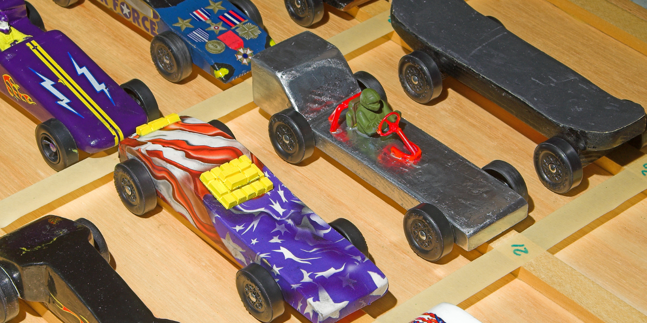
See Also
http://www.oracle.com/technetwork/java/javadb/overview/index.html
https://db.apache.org/derby/
Notes:
Some additional information on concurrency

Slide 3
Apache Derby
Installed with the JDK
Small footprint (around 2.6 megabytes)
Written in Java
Easy to deploy
Can be embedded in your application
FREE
Streams of bytes … two ways (into your program and out of your program)
Disks, consoles, sockets, keyboards, printers
Know how to talk streams and you can talk to anything
Initialization (constructor) is different. Use is the same.

Slide 4
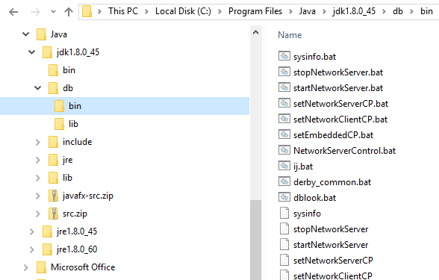
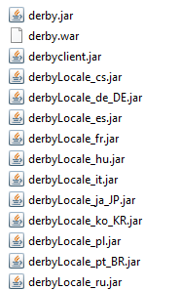
Apache Derby in the JDK
set path=%path%;"c:\Program Files\Java\jdk1.8.0_45\db\bin"
Streams of bytes … two ways (into your program and out of your program)
Disks, consoles, sockets, keyboards, printers
Know how to talk streams and you can talk to anything
Initialization (constructor) is different. Use is the same.

Slide 5
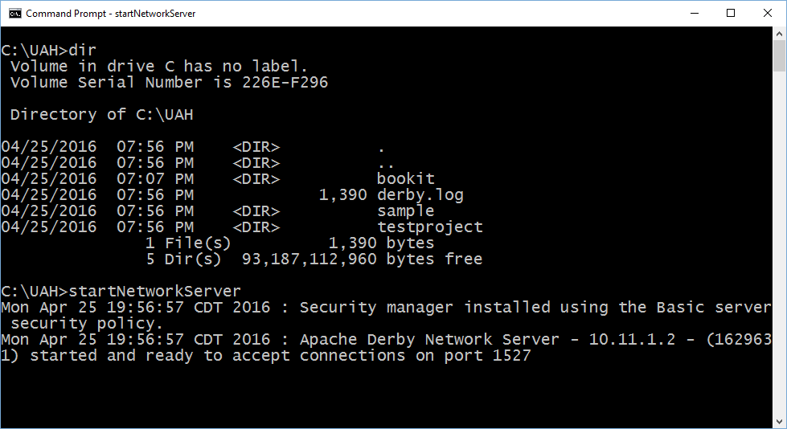
Starting the Database
Streams of bytes … two ways (into your program and out of your program)
Disks, consoles, sockets, keyboards, printers
Know how to talk streams and you can talk to anything
Initialization (constructor) is different. Use is the same.

Slide 6
Access and Authentication
Authentication is OFF by default, but you can configure a variety of user-authentication schemes.
Only connections on localhost by default, but you can enable remote connections.
Streams of bytes … two ways (into your program and out of your program)
Disks, consoles, sockets, keyboards, printers
Know how to talk streams and you can talk to anything
Initialization (constructor) is different. Use is the same.

Slide 7
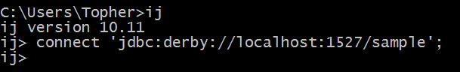
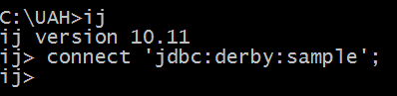
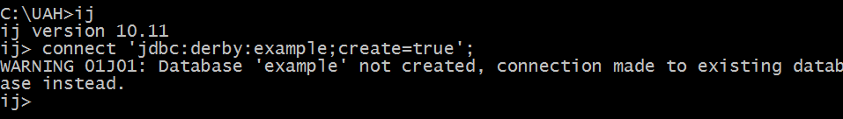
ij – Command Line Tool
Streams of bytes … two ways (into your program and out of your program)
Disks, consoles, sockets, keyboards, printers
Know how to talk streams and you can talk to anything
Initialization (constructor) is different. Use is the same.

Slide 8

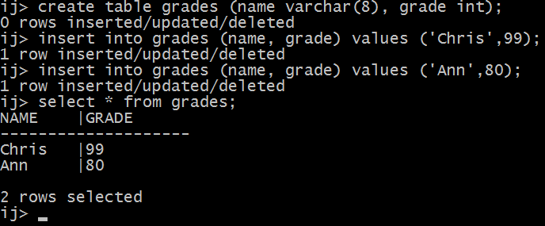
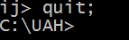
SQL Command Line
Streams of bytes … two ways (into your program and out of your program)
Disks, consoles, sockets, keyboards, printers
Know how to talk streams and you can talk to anything
Initialization (constructor) is different. Use is the same.

Slide 9
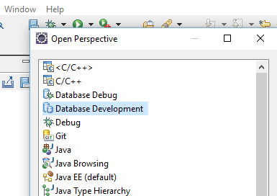
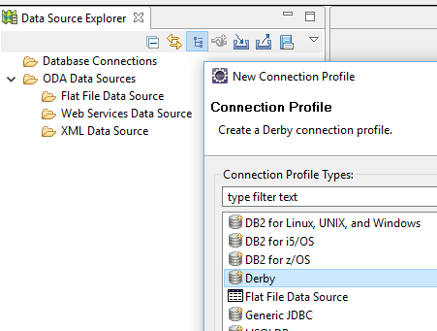
Eclipse DB Tools
Streams of bytes … two ways (into your program and out of your program)
Disks, consoles, sockets, keyboards, printers
Know how to talk streams and you can talk to anything
Initialization (constructor) is different. Use is the same.

Slide 10
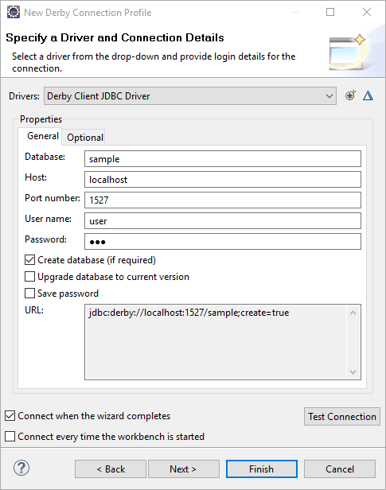
Eclipse DB Tools
Username/password must be given but is ignored
You can create a new DB here
May have to configure driver first time
Streams of bytes … two ways (into your program and out of your program)
Disks, consoles, sockets, keyboards, printers
Know how to talk streams and you can talk to anything
Initialization (constructor) is different. Use is the same.

Slide 11
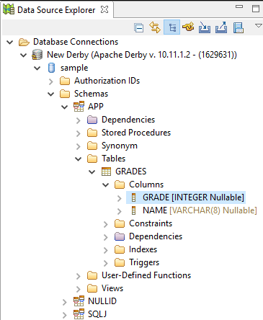
Eclipse DB Tools
Surf the DB like a filesystem
Right click on table to see “Sample Content”
Right click on project to open “SQL Scrapbook”
Streams of bytes … two ways (into your program and out of your program)
Disks, consoles, sockets, keyboards, printers
Know how to talk streams and you can talk to anything
Initialization (constructor) is different. Use is the same.

Slide 12
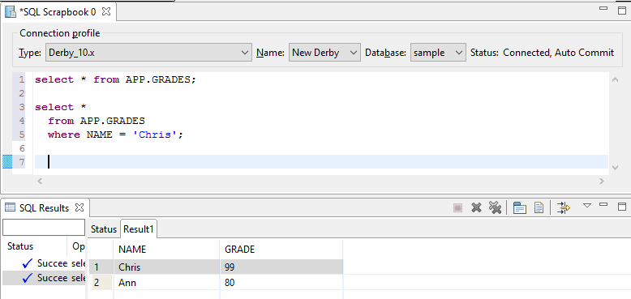
Eclipse DB Tools
Select the “Database”
Highlight text and right-click for run options
Errors and Results at the bottom
Streams of bytes … two ways (into your program and out of your program)
Disks, consoles, sockets, keyboards, printers
Know how to talk streams and you can talk to anything
Initialization (constructor) is different. Use is the same.

Slide 13

Tinkering
Start the Derby network server.
Connect to the DB with IJ and create a GRADES table (look for sample SQL on the web).
Use Eclipse to explore the new database.
Notes:
Here are some things to think about … nothing to submit.
Share your thoughts in the online portal discussion area.

